Slide 1
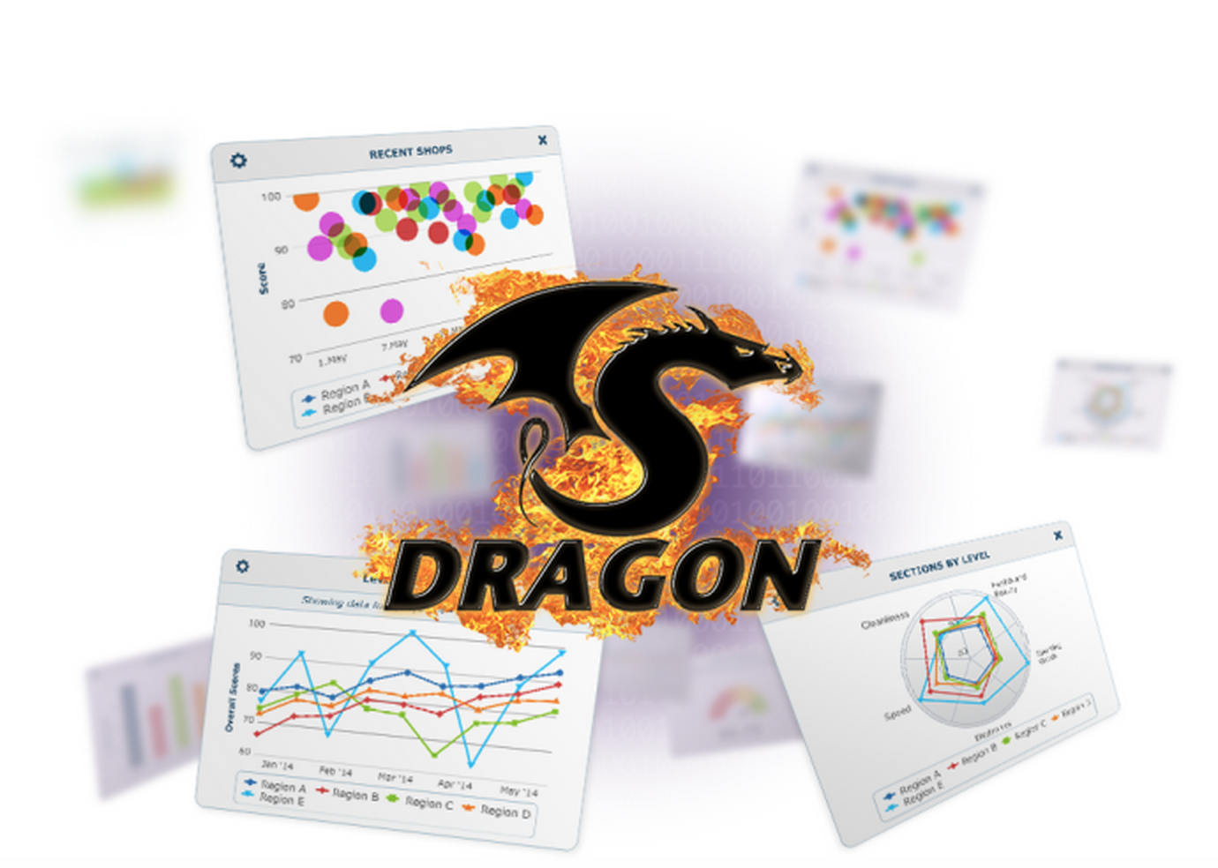
Dragon

Slide 2
We Made It Easy
Easy to Make
Easy to View
Easy to Share
Easy to Find Insights

Slide 3
We Made It Easy
Why?

Slide 4
We Made It Easy
So the features get used!

Slide 5

Dragon Dashboard App

Slide 6
Dragon Dashboard App
Securely connects the user to the specific device
Never have to log in again

Slide 7
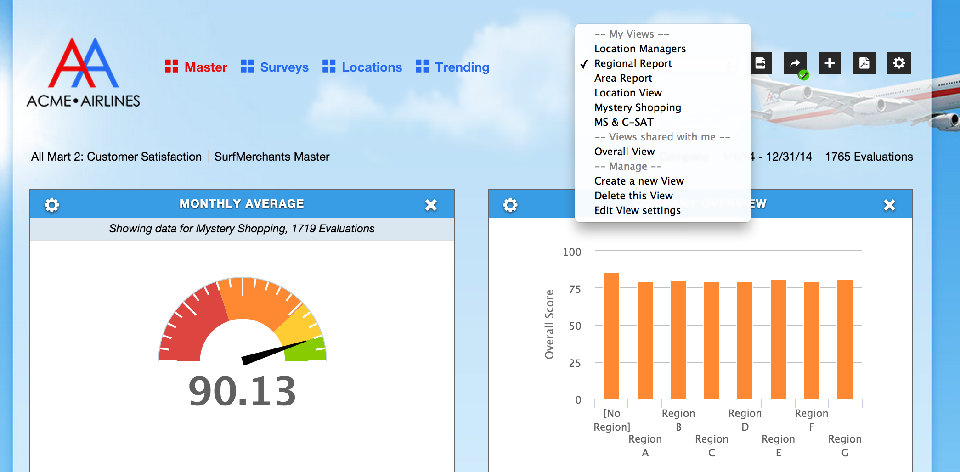
Quick Overview – Tabs & Views

Slide 8
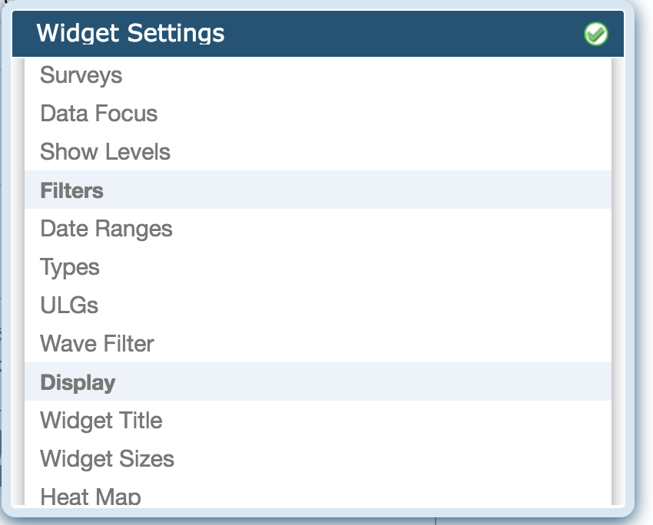
Complex Individual Filters

Slide 9
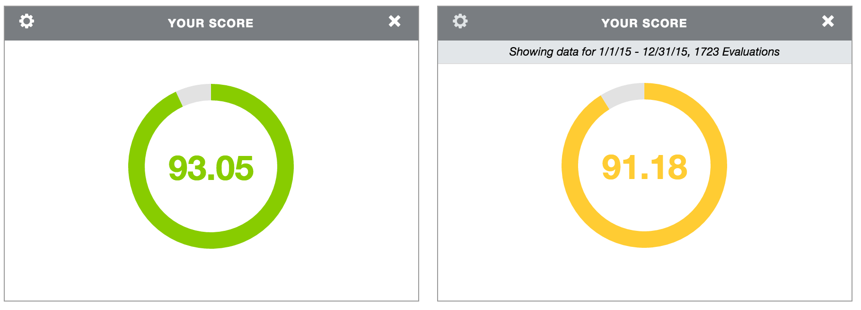
Complex Individual Filters
Mystery shop Survey
Corporate Stores
Bathrooms
Lunch
C-SAT Survey
Franchise Stores
No Bathrooms
Dinner

Slide 10
Widgets

Slide 11
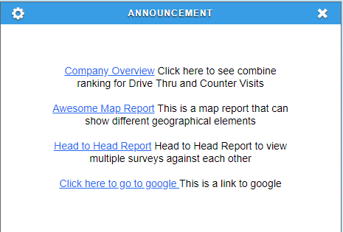
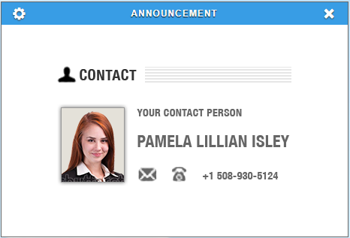
Announcement Widgets
Write custom text and display a message to your users
Supports basic formatting
Play videos right in the dashboard

Slide 12
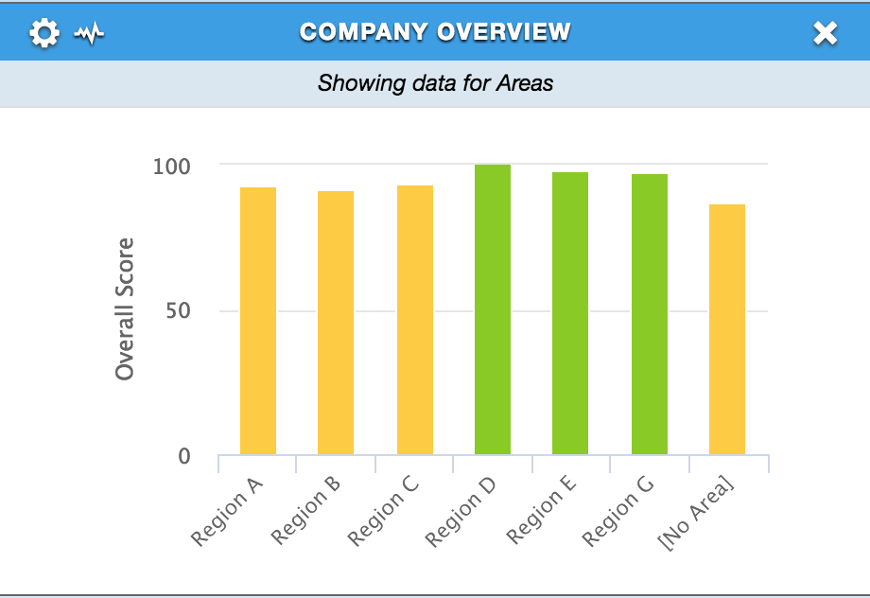
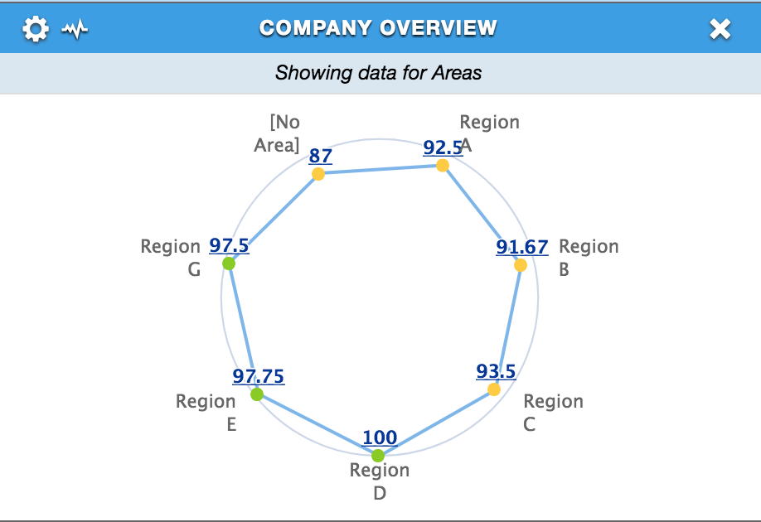
Company Overview
Percentage scores for hierarchical levels
Drill-down through the hierarchy
Can be configured to show peer data
Default to a specific level

Slide 13
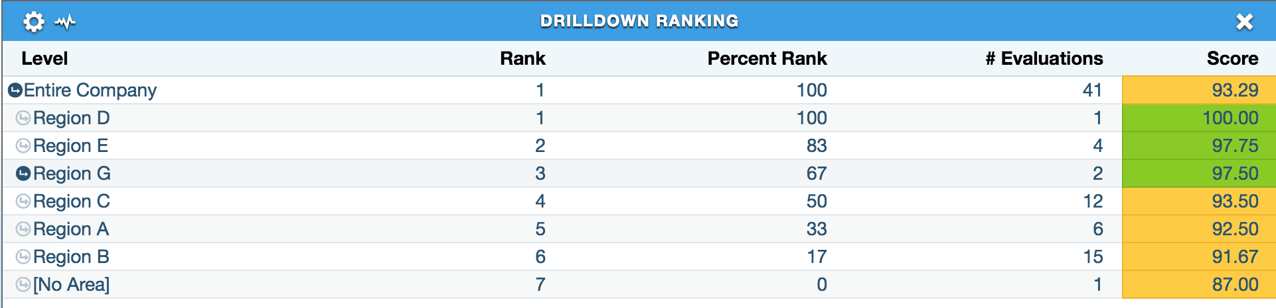
Drill Down Ranking
Rank all locations
Configure to Overall, Section, or Question scores
Each level ordered from highest to lowest rank
Levels can be tied
Drilldown into levels below you in the hierarchy

Slide 14
Flashpoints
Outlier reports
Use statistical analysis to know the data you should be looking at
Stop downward trends before they get worse
Highest to lowest deviation from the norm
  Three types:
    Level vs Hierarchy
    Level vs History
    Question vs History

Slide 15
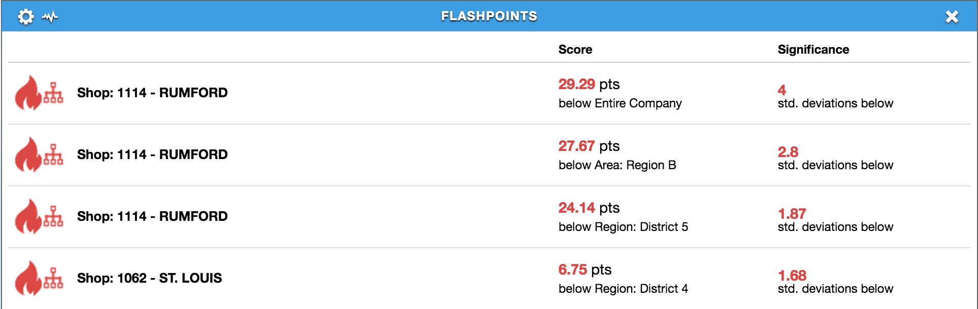
Flashpoints – Level vs Hierarchy
Levels that differ significantly from others in their hierarchy for the current date range
Which specific locations are dragging down your scores?
Which locations have improved significantly and deserved recognition?

Slide 16
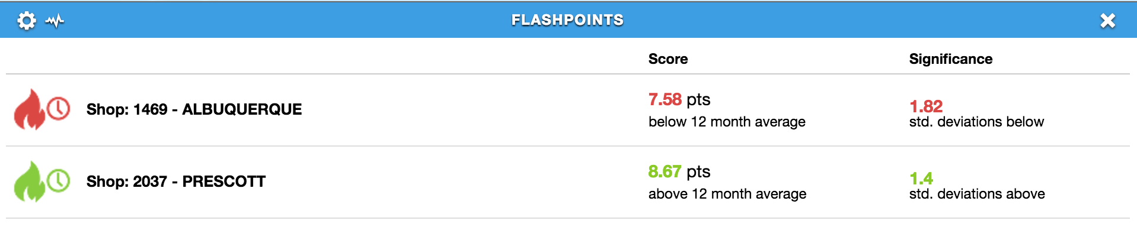
Flashpoints – Level vs History
Levels whose scores differ significantly from the 12-month average
Pinpoint trends and outliers early before they drag down the overall score

Slide 17
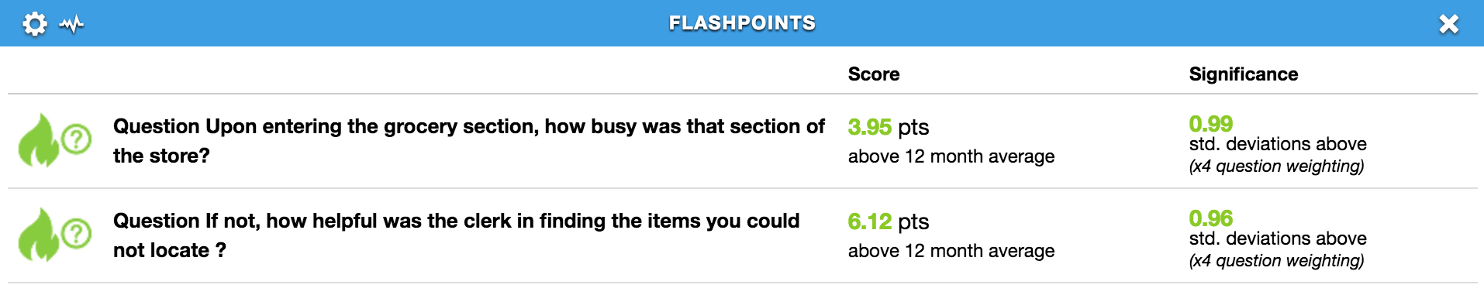
Flashpoints – Question vs History
Questions whose score differs significantly from their 12-month average
What specific KPIs do we need to focus on?
What specific KPIs have improved?

Slide 18
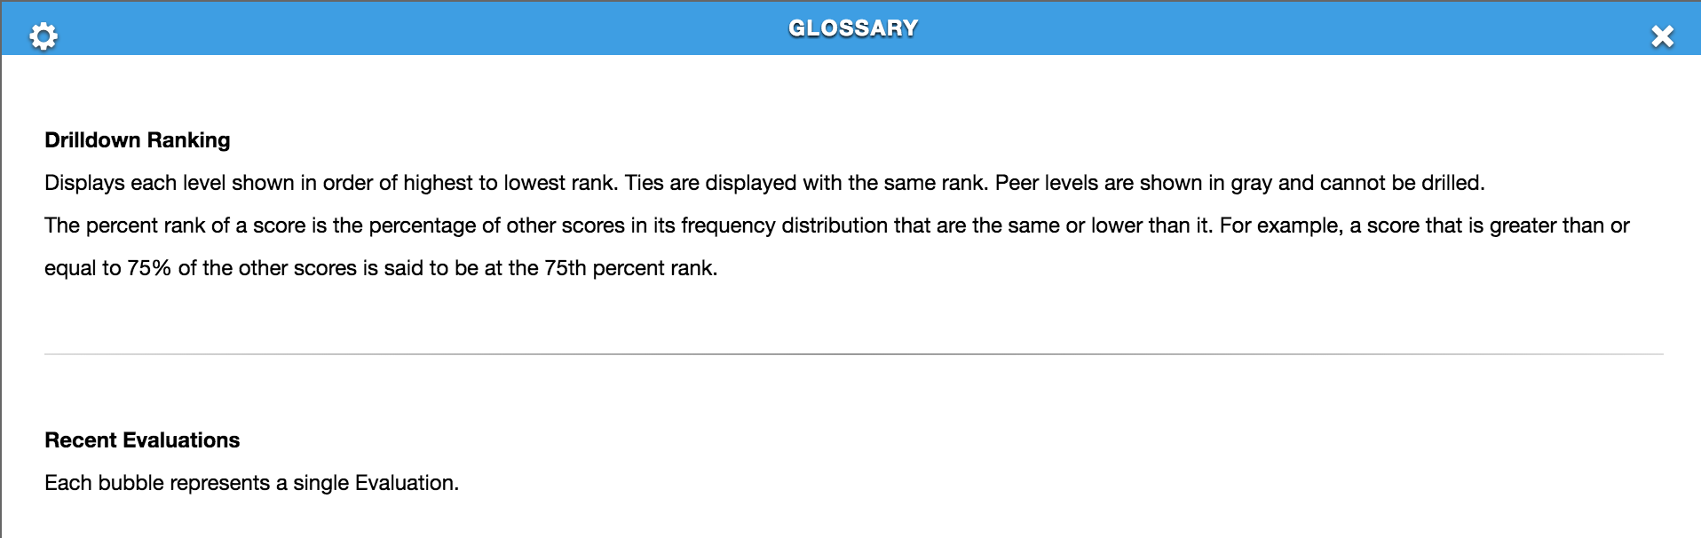
Glossary
Description/definition of each widget currently in the view
Eliminates confusion
Can be included on PDFs

Slide 19
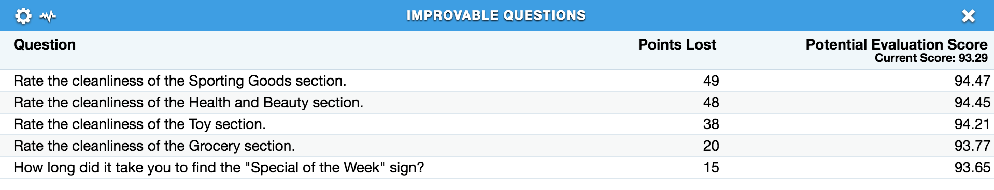
Improvable Questions
Questions that have lost the most points over the selected date range
Demonstrates potential score if these questions had been answered correctly

Slide 20
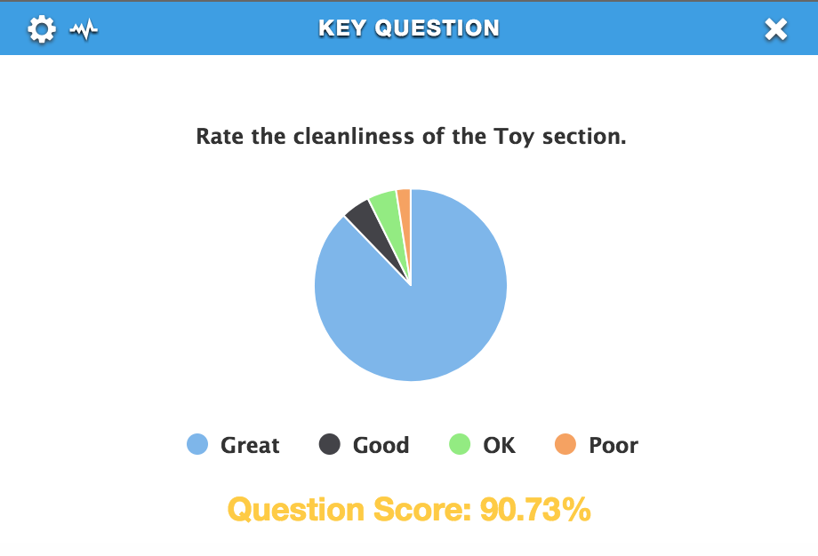
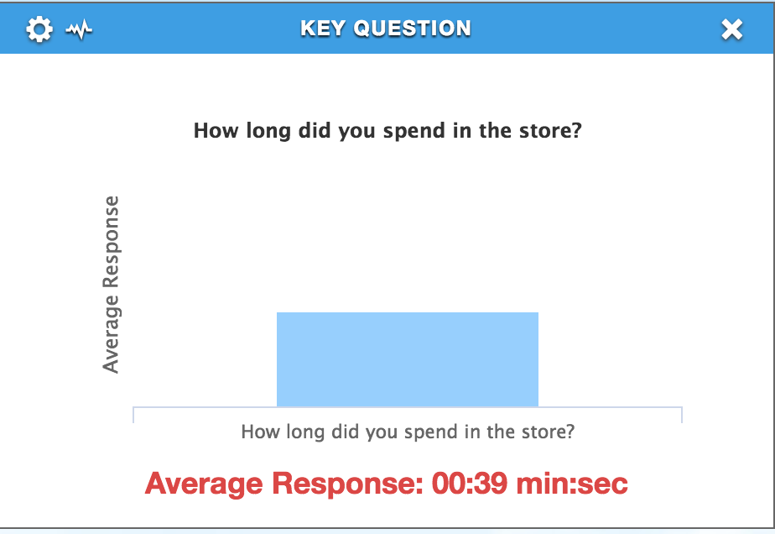
Key Question
Distribution of answer options for a single question
Question percentage score

Slide 21
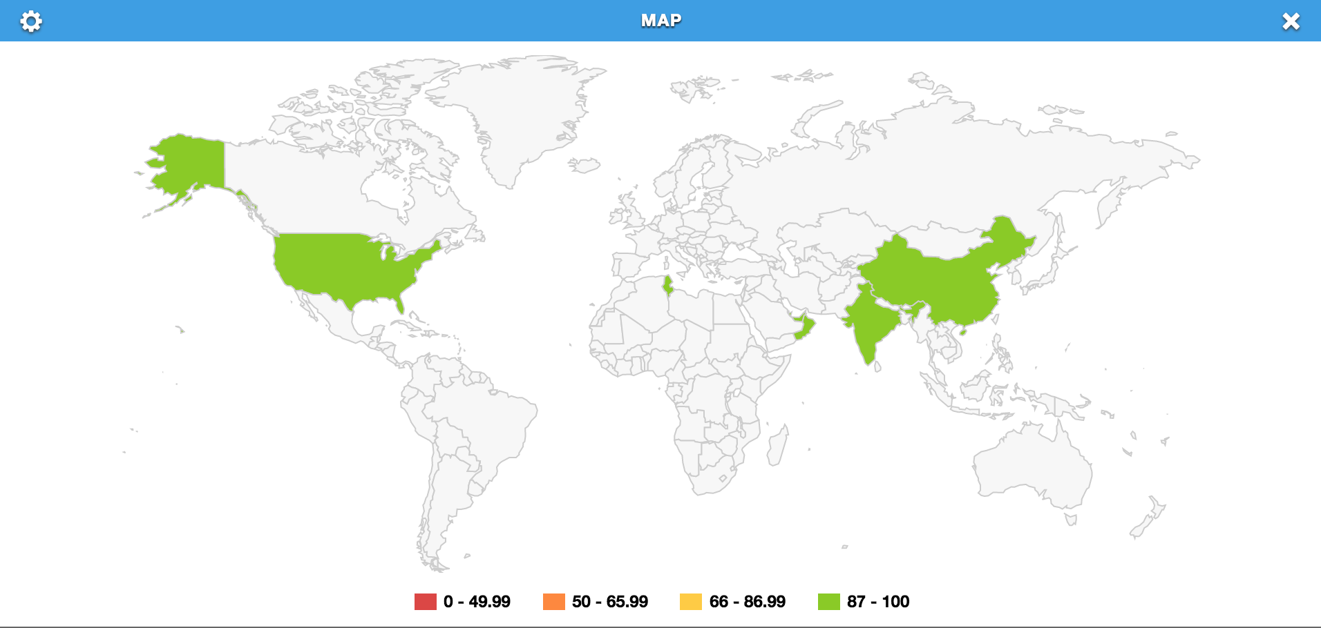
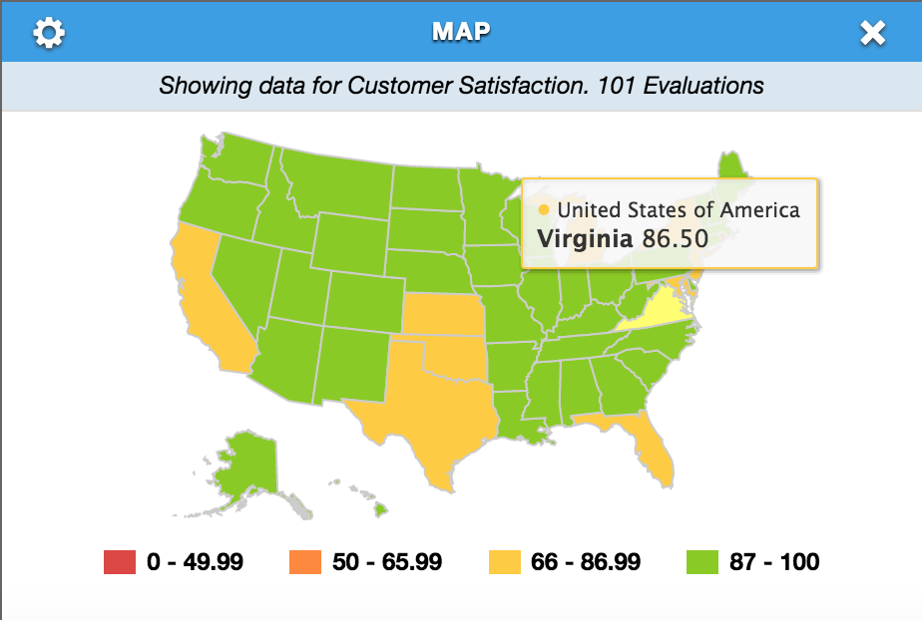
Maps
Heat-mapped overall or sectional scores for countries and states
Click a country to see scores for states

Slide 22
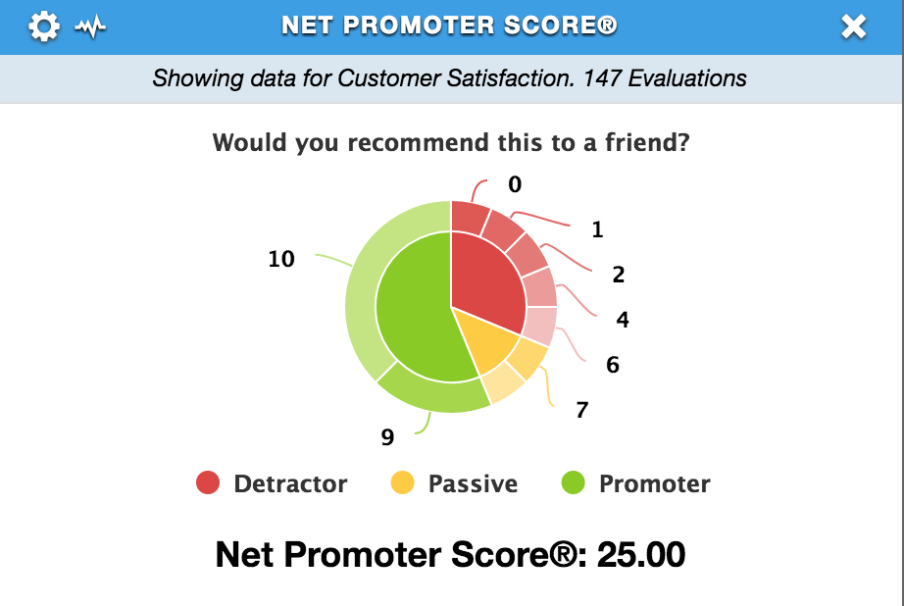
Net Promoter Score -NPS
Percentage of promoters minus detractors
Measure of customer satisfaction
Mystery shopping/C-Sat

Slide 23
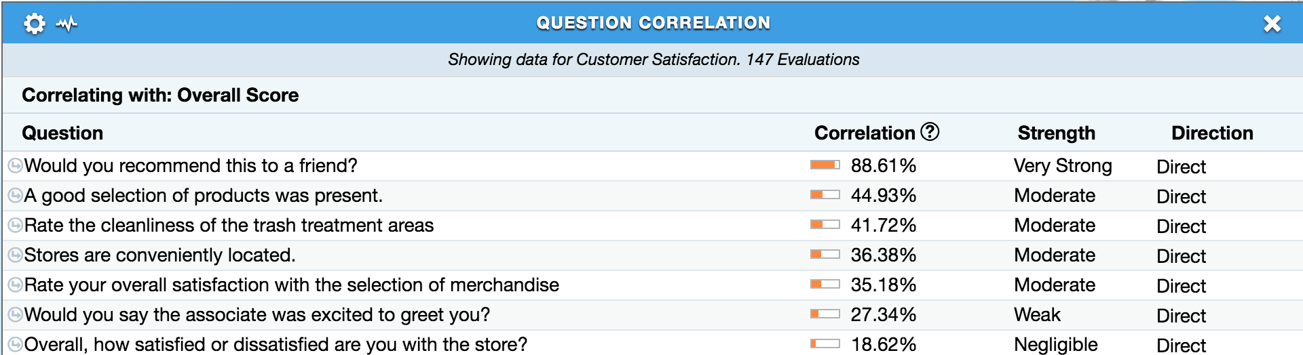
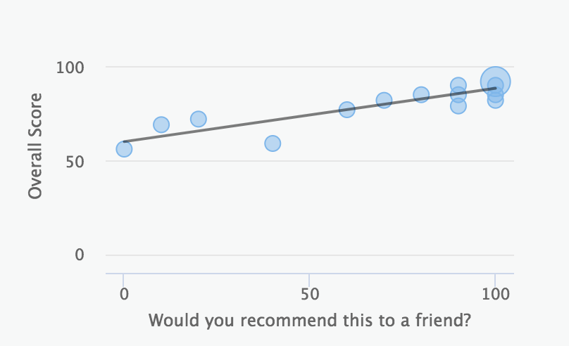
Question Correlation
Statistical relationship between two scores
Can be configured to overall score, section scores, or question scores
Ordered from most highly correlated to least correlated
Correlation ranges from 0% to 100%
Direct vs. Inverse correlation

Slide 24
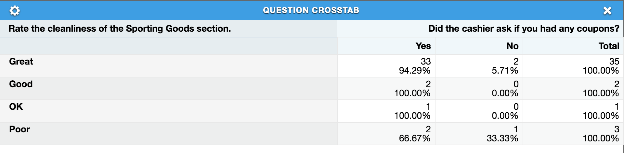
Question Crosstab
Frequency of each possible answer combination for two questions selected
Configured for counts or percentages
Market research

Slide 25
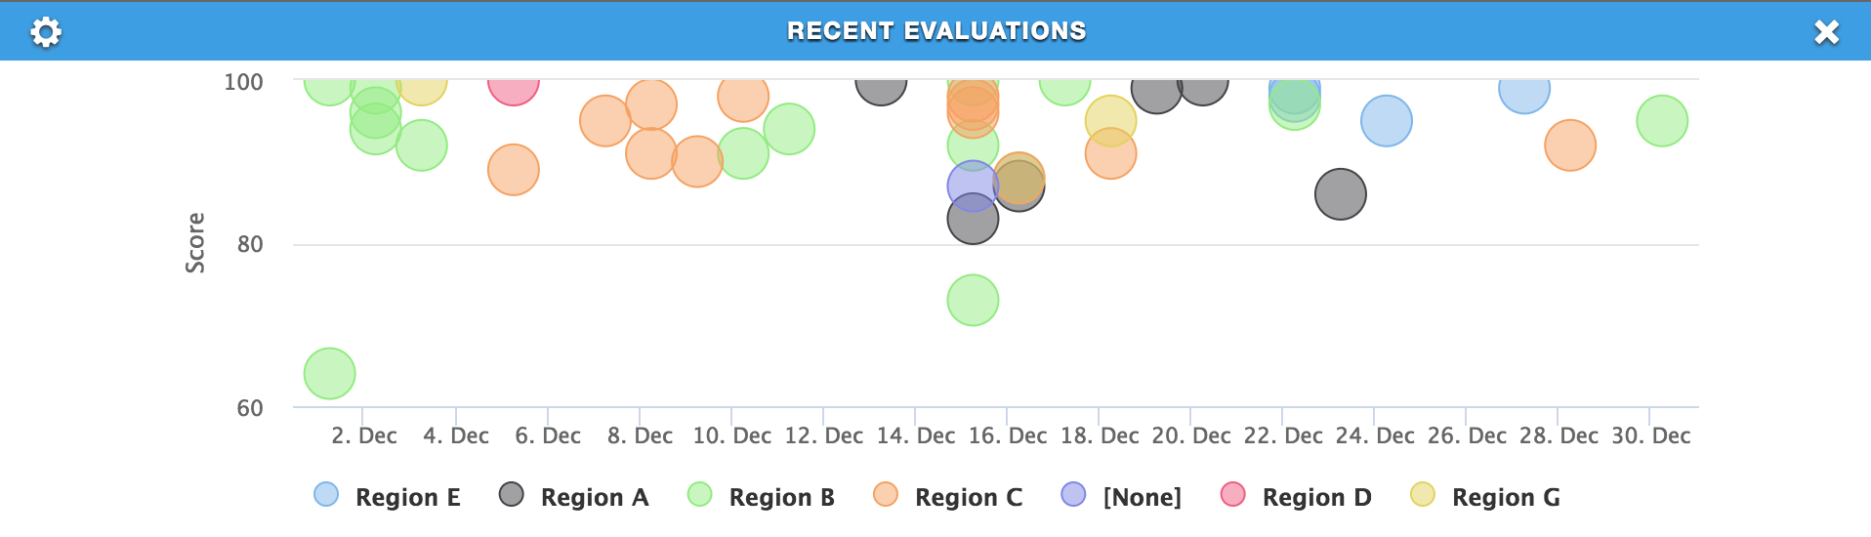
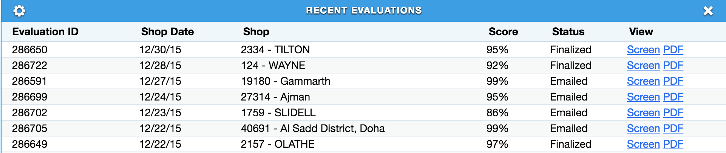
Recent Evaluations
Log or scatter plot of recent jobs and their overall scores
Click into each to see the individual shop view

Slide 26
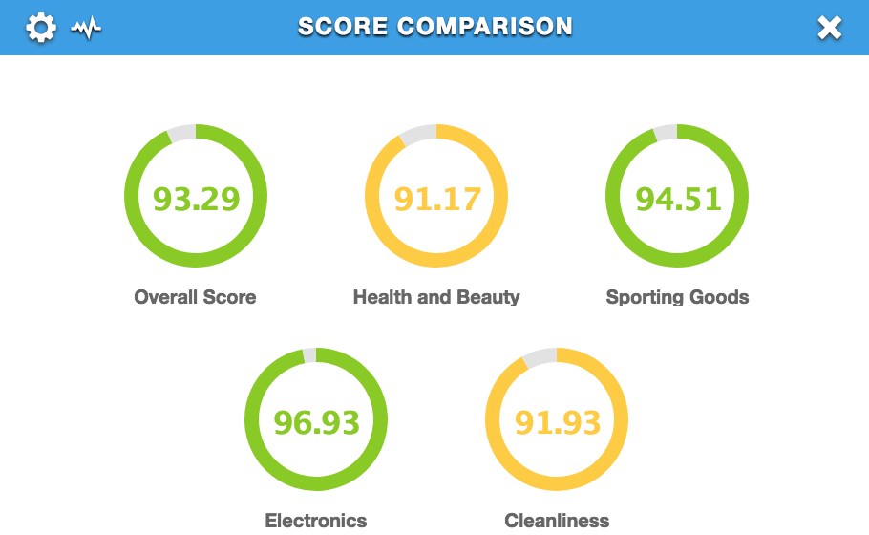
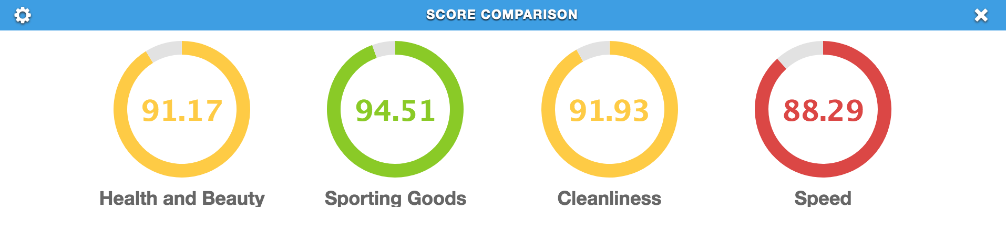
Score Comparison
Question, section, or overall scores in the same widget
Configure look and feel
  Max items per row
  Graph types
  Log view

Slide 27
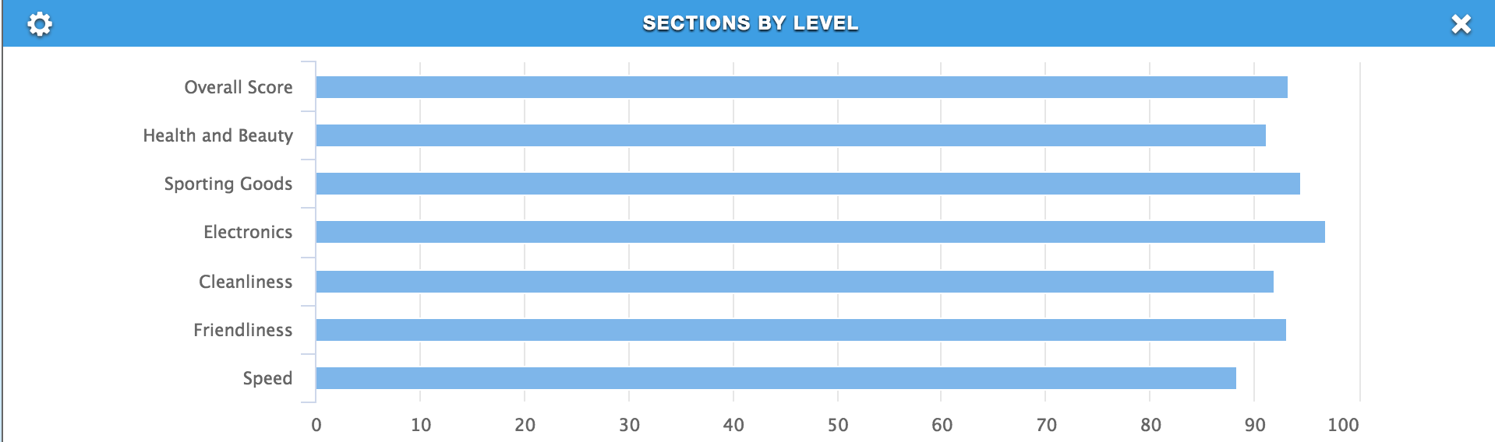
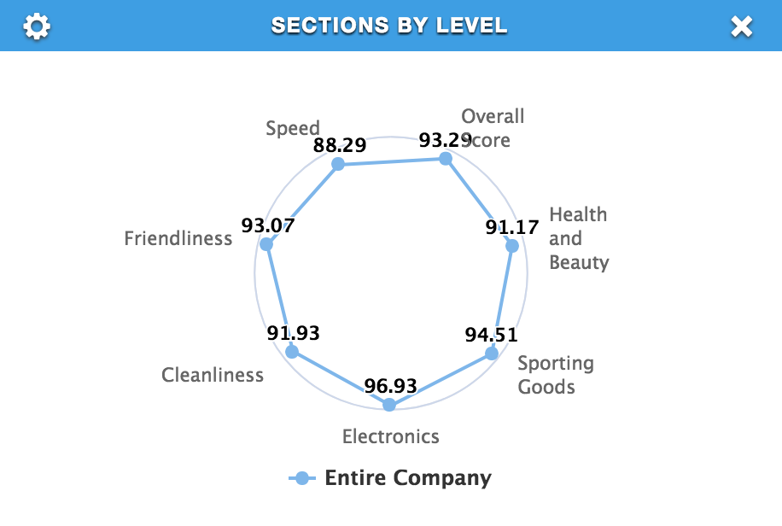
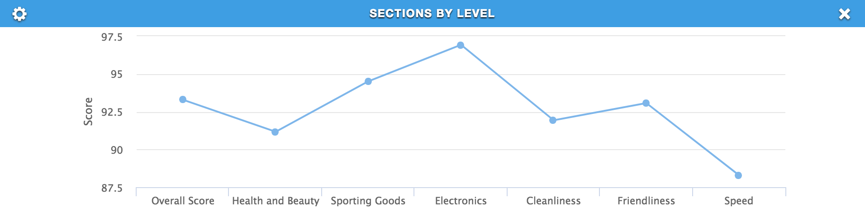
Sections by Level
Compare sectional scores for levels

Slide 28
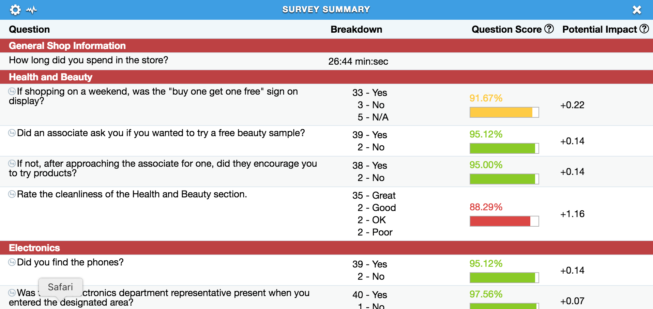
Survey Summary
Individual question reporting for a single survey
Configurable columns
Show/hide by section

Slide 29
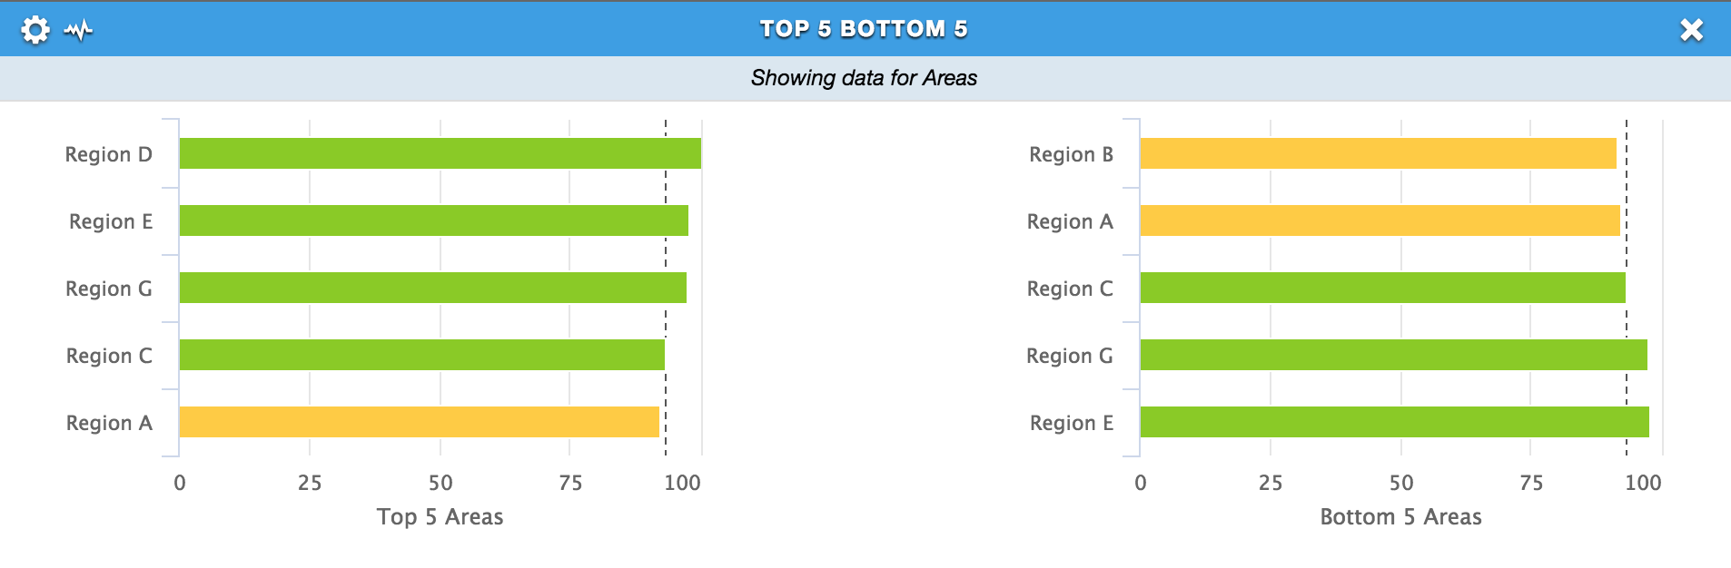
Top x Bottom x
Show top and bottom levels/locations in the hierarchy
Configure number, only top/bottom, overall or sectional scores
Compare against company average

Slide 30
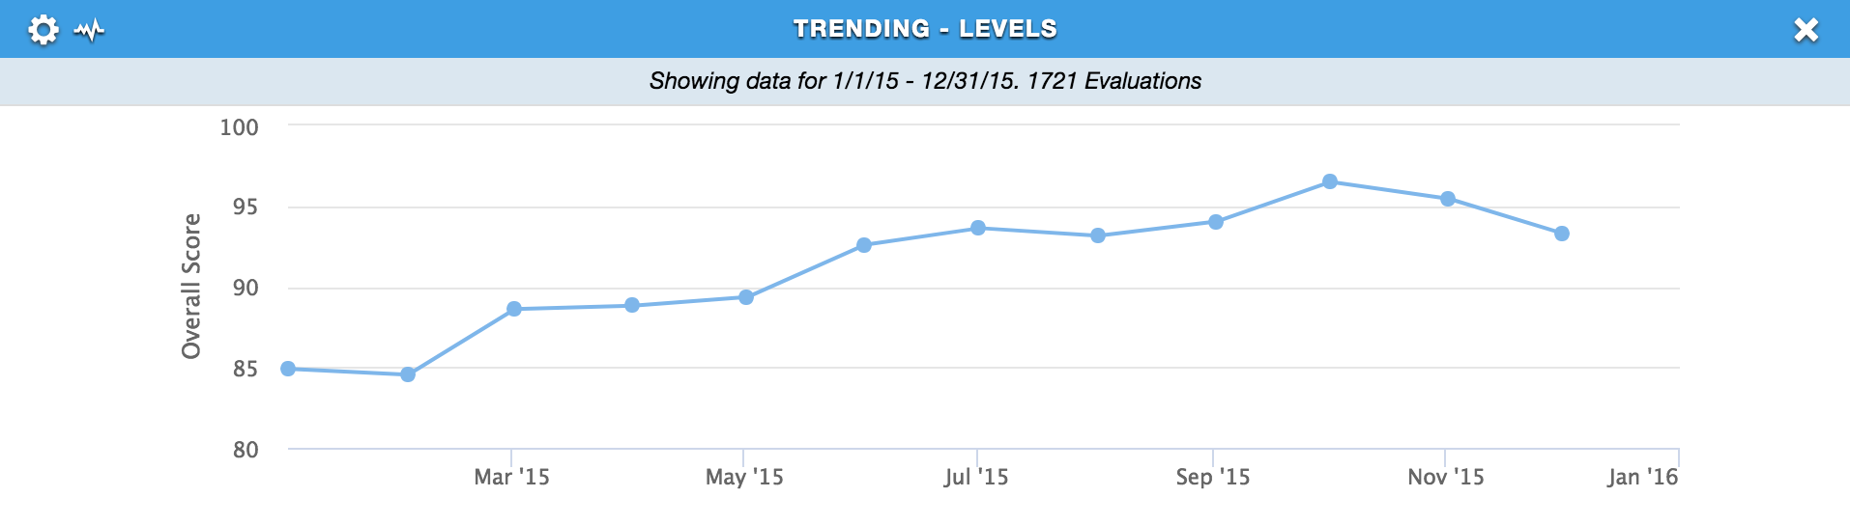
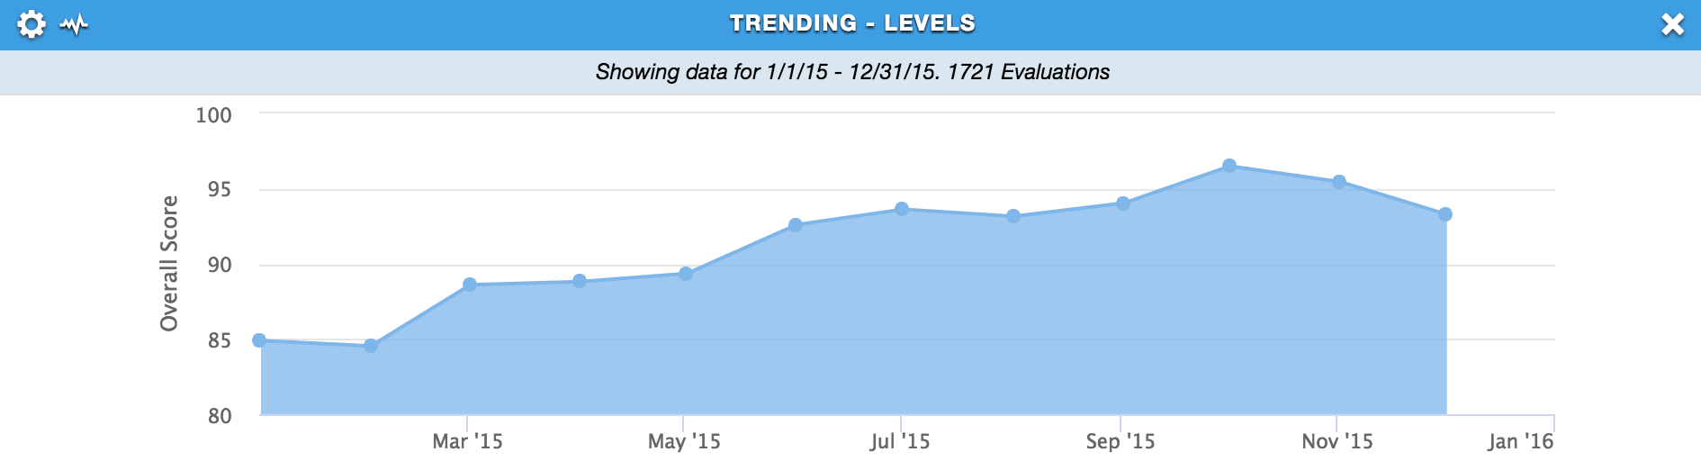
Trending - Levels
Level’s score over time
Filters automatically by permission
Hide/show clicking, drag zoom

Slide 31
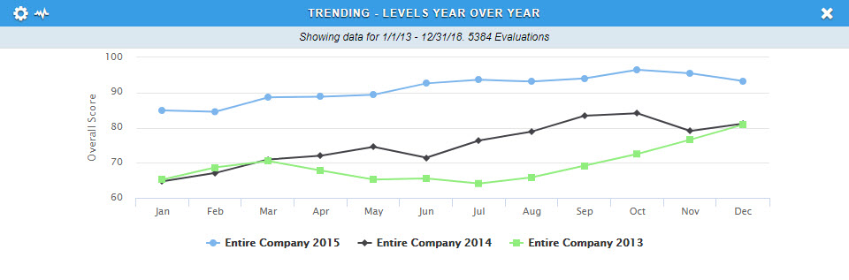
Trending - Levels Year Over Year
Trend levels across multiple years
Configure number of years
Configure specific levels

Slide 32
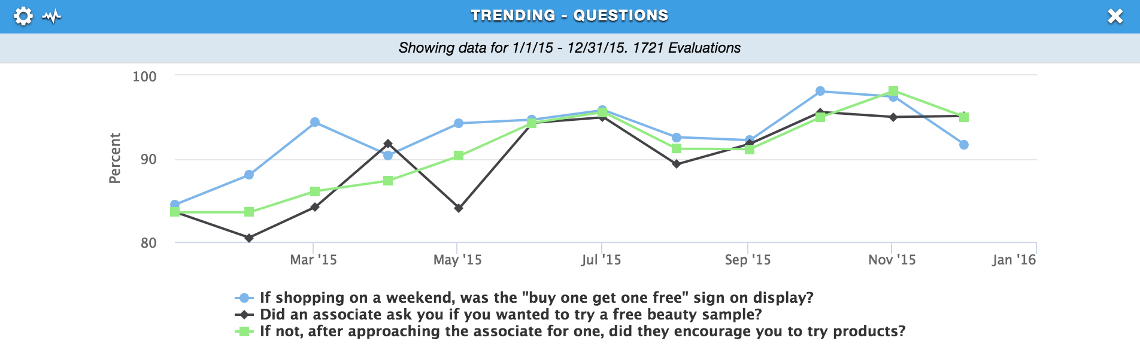
Trending - Questions
Track a question’s performance over time
Configure multiple questions

Slide 33
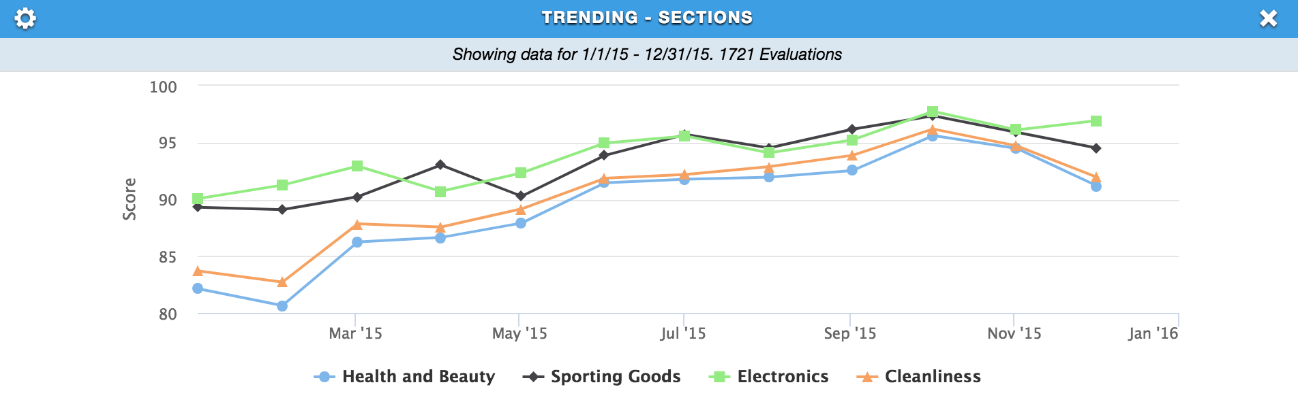
Trending - Sections
Track a section’s performance over time
View multiple sections/KPIs at once

Slide 34
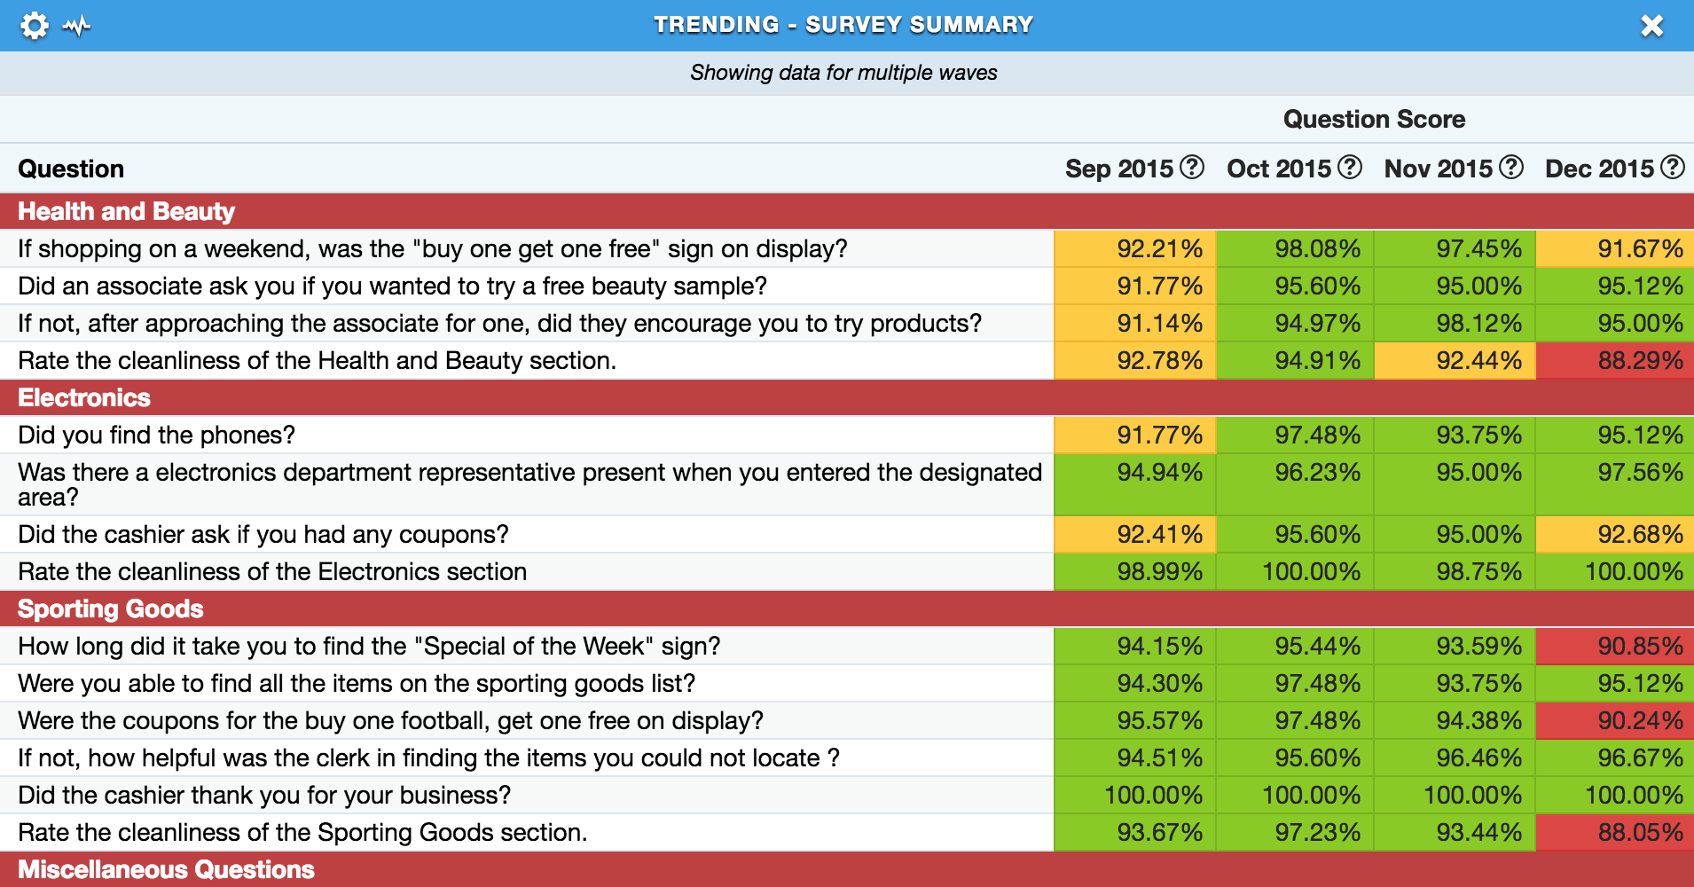
Trending - Survey Summary
Trend multiple question scores across periods
Configurable number of periods
Heatmapping for easy identification
Configurable columns

Slide 35
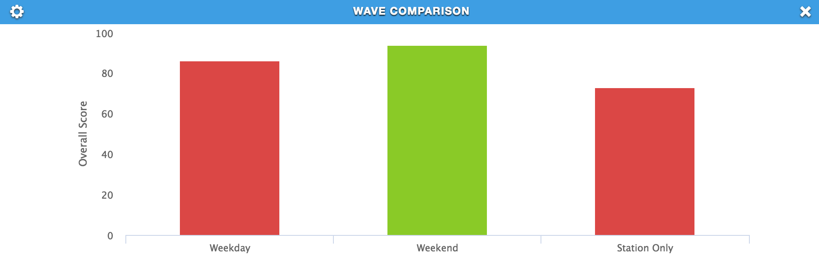
Wave Comparison
Compare scenarios
Same checklist, different instructions or parameters

Slide 36
Business Intelligence
What the user should be looking at now
What is behind the numbers

Slide 37
Business Intelligence
To show them what they need to look at!

Slide 38
Business Intelligence
Improvable Questions
Survey Summary
Trending Survey Summary
Question Correlation
Flash Points
EKG

Slide 39
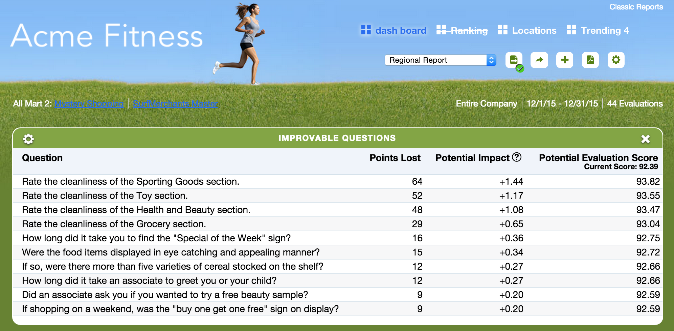
Improvable Questions

Slide 40
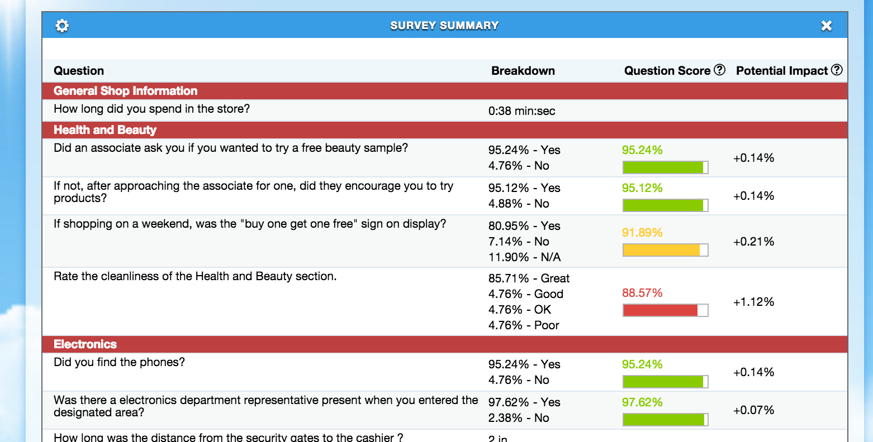
Survey Summary

Slide 41
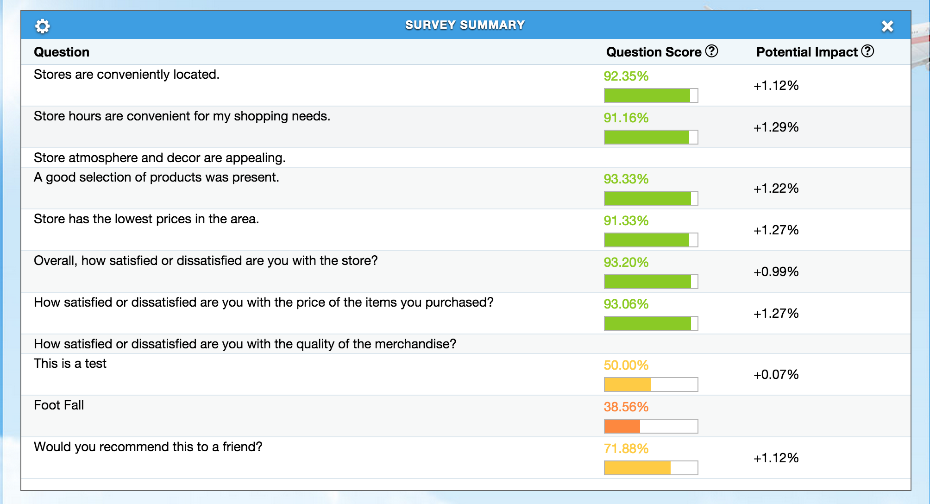
Survey Summary

Slide 42
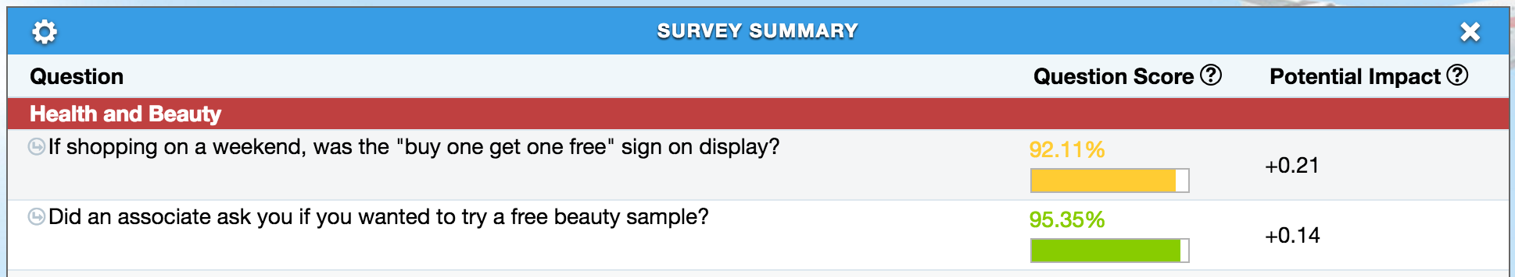
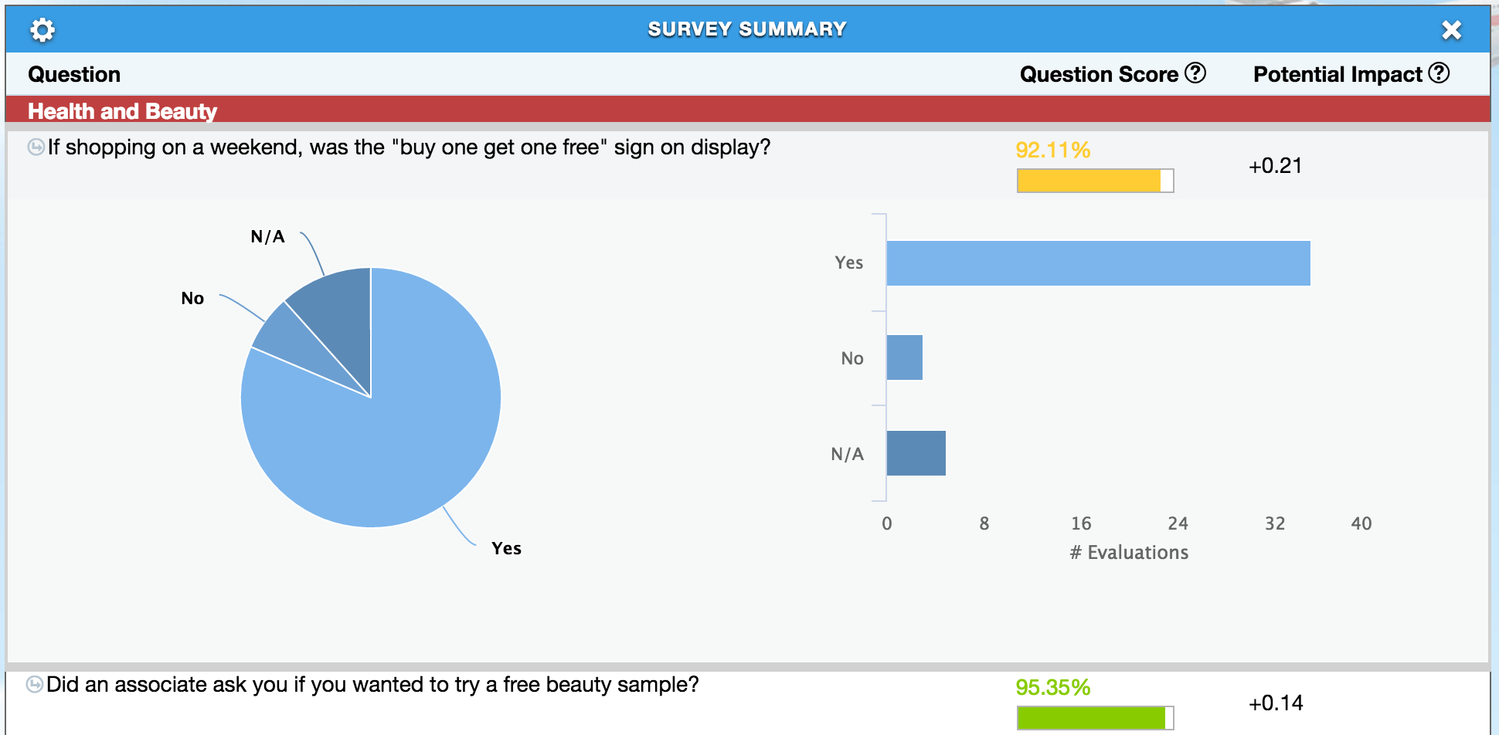
Survey Summary (Now W/ Visualization)

Slide 43
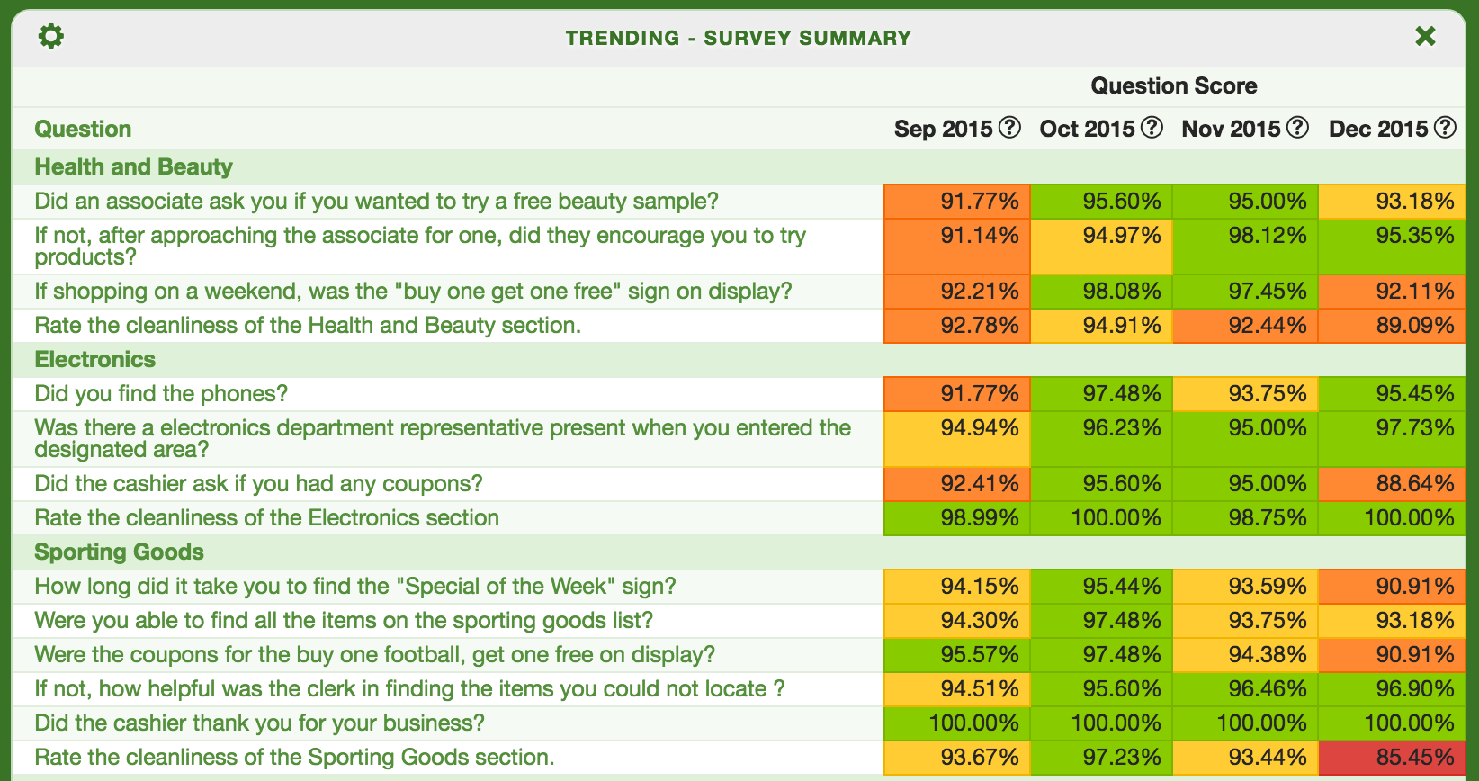
Trending Survey Summary

Slide 44
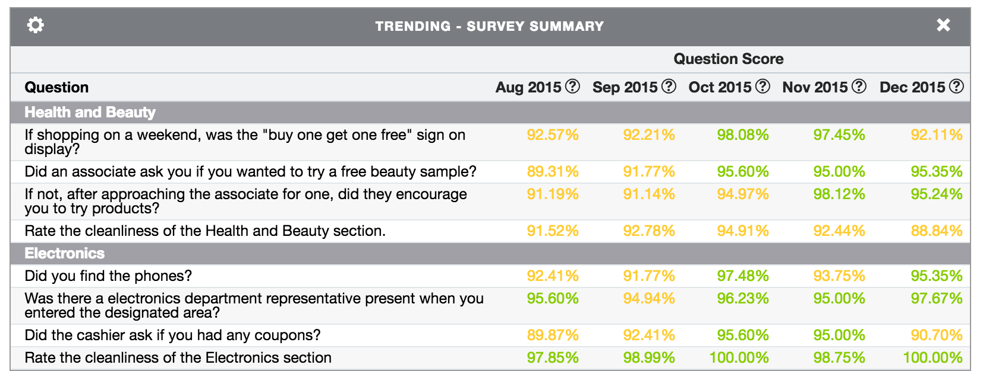
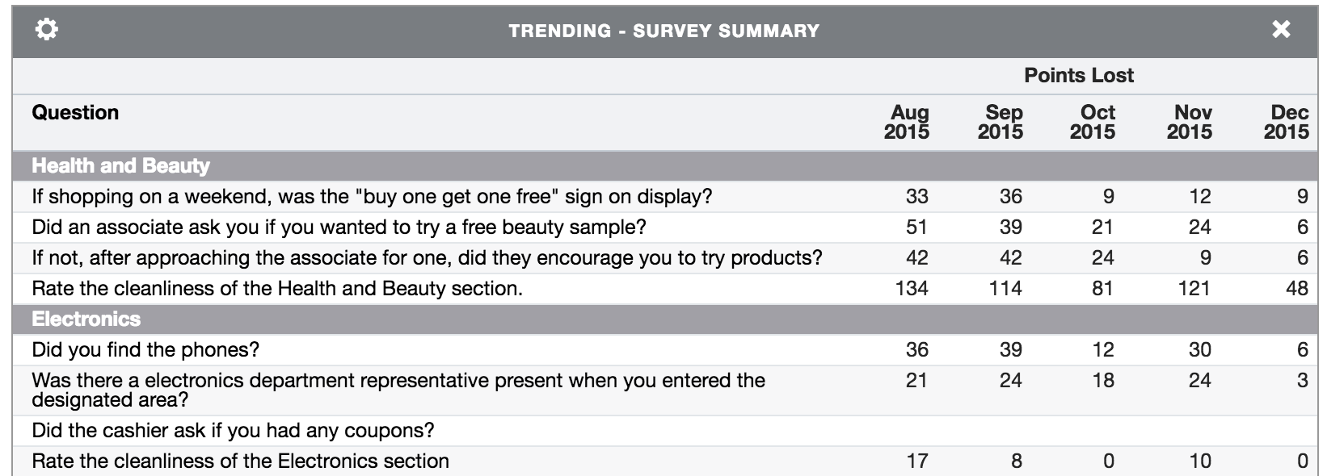
Trending Survey Summary

Slide 45
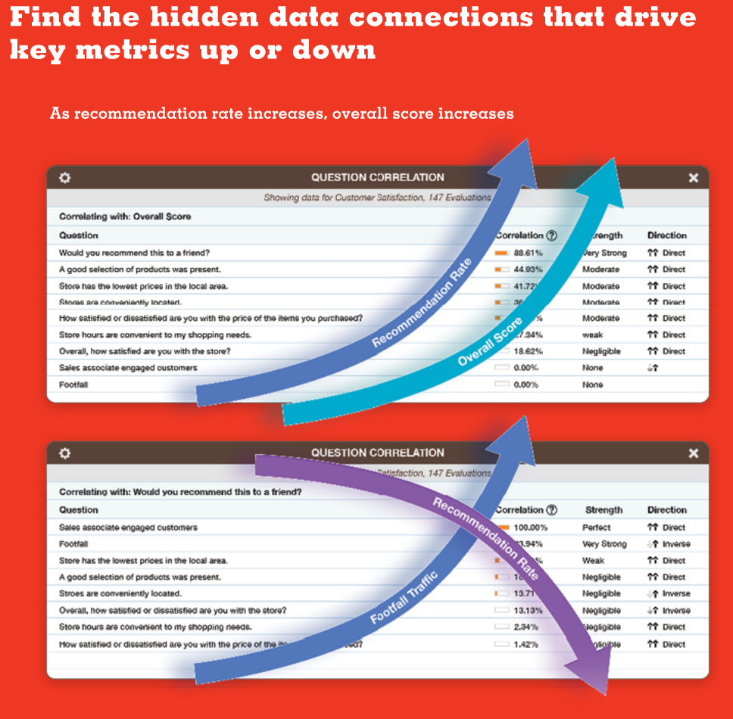
Question Correlation

Slide 46
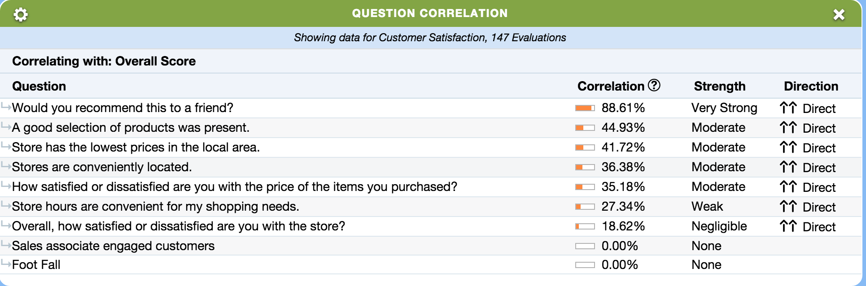
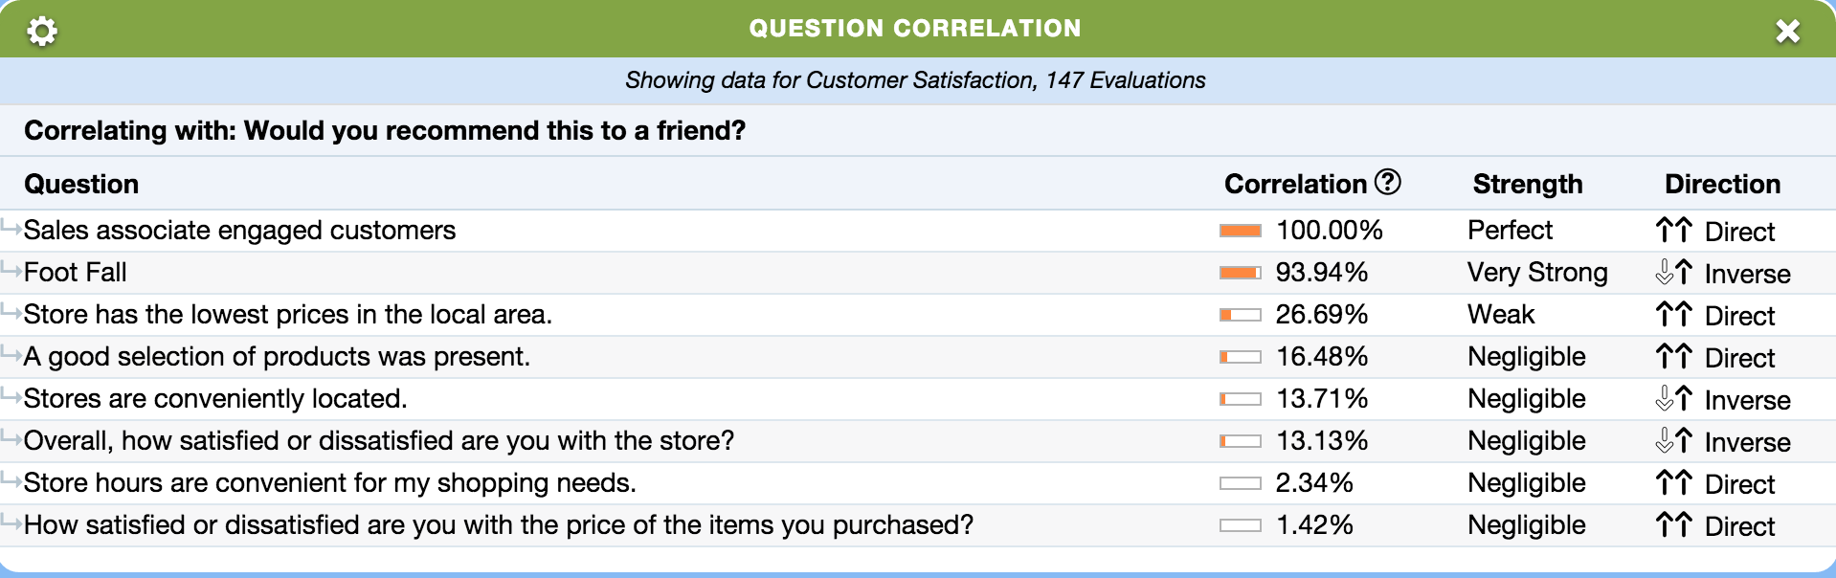
Question Correlation

Slide 47
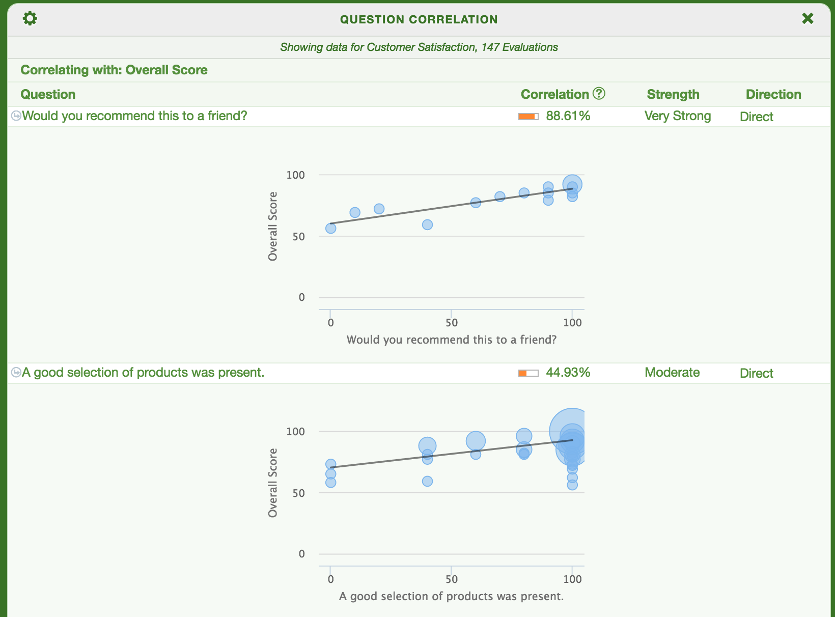
Question Correlation

Slide 48
Flashpoints 3 Types
Level Vs. Hierarchy
Level Vs. History
Questions Vs. History

Slide 49

Flashpoints

Slide 50

Flashpoints – Level Vs. Hierarchy

Slide 51

Flashpoints – Level Vs. History

Slide 52

Flashpoints – Question Vs. History

Slide 53

EKG

Slide 54




EKG

Slide 55


EKG – Hierarchy

Slide 56


EKG – Questions

Slide 57

Logs

Slide 58

Locations

Slide 59

Default View In Dragon

Slide 60
Data Mining In Dragon
Filter the results of all widgets that report on jobs by any questions

Slide 61

Data Mining In Dragon

Slide 62
Dragon Geographic
Widgets can use geographic positioning
No need to make geographic areas levels

Slide 63


Dragon Geographic – Co Overview

Slide 64

Dragon Geographic – Drill Down

Slide 65


Distribution By CDR
Schedule report delivery by any custom date range

Slide 66


Action Plans- Action Item Log

Slide 67


Action Plans – Reports (Dragon)

Slide 68

Action Plans – Reports (Dragon)

Slide 69

Action Plans – Reports (Dragon)

